Slide 1

Evolution of C++
C++ programming language was developed in 1980 by Bjarne Stroustrup at bell laboratories of AT&T (American Telephone & Telegraph), located in U.S.A.
Bjarne Stroustrup is known as the founder of C++ language.
It was develop for adding a feature of OOP
(Object Oriented Programming) in C without
significantly changing the C component.
C++ programming is "relative" (called a
superset) of C, it means any valid C program
is also a valid C++ program.

Slide 2
Evolution of programming languages
Language | Year | Developed By
Algol | 1960 | International Group
BCPL | 1967 | Martin Richard
B | 1970 | Ken Thompson
Traditional C | 1972 | Dennis Ritchie
K & R C | 1978 | Kernighan & Dennis Ritchie
C++ | 1980 | Bjarne Stroustrup

Slide 3
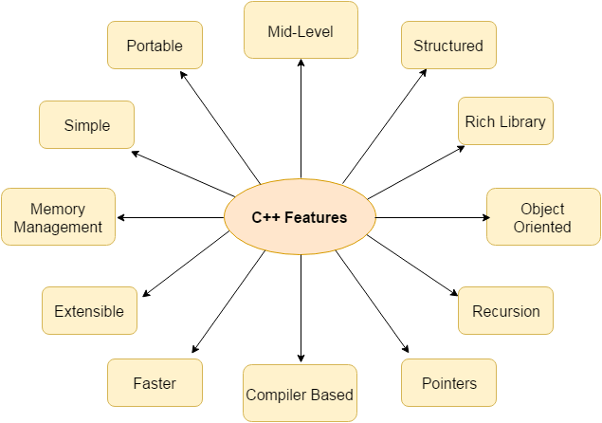
Features of C++

Slide 4
Basics of C++ programming
C++ Tokens:-
The text of a C++ program consists of tokens and white space.
A token is the smallest element of a C++ program that is meaningful to the compiler
.
The C++ parser recognizes these kinds of tokens:
Keywords
Identifiers
Numeric, Boolean and Pointer Literals
String and Character Literals
User-Defined Literals
Operators
Punctuators
Tokens are usually separated by white space, which can be one or more:
Blanks
Horizontal or vertical tabs
New lines
Form feeds
Comments

Slide 5
Basics of C++ programming
C++ comments:-
A comment is text that the compiler ignores but that is useful for programmers.
Comments are normally used to annotate code for future reference.
The compiler treats them as white space.
A C++ comment is written in one of the following ways:
The /* (slash, asterisk) characters, followed by any sequence of characters (including new lines), followed by the */ characters. This syntax is the same as ANSI C. It is basically known as multi-line comment.
The // (two slashes) characters, followed by any sequence of characters. A new line not immediately preceded by a backslash terminates this form of comment. Therefore, it is commonly called a "single-line comment."

Slide 6
Basics of C++ programming
C++ Identifier:-
An identifier is a sequence of characters used to denote one of the following:
Object or variable name
Class, structure, or union name
Enumerated type name
Member of a class, structure, union, or enumeration
Function or class-member function
typedef name
Label name

Slide 7
Basics of C++ programming
C++ keywords:-
Keywords are predefined reserved identifiers that have special meanings. They can't be used as identifiers in your program.
Standard C++ keywords
int long unsigned throw true for if
else enum explicit short return char case
try catch exit public private protected

Slide 8
Basics of C++ programming
C++ keywords:-
Keywords are predefined reserved identifiers that have special meanings. They can't be used as identifiers in your program.
Standard C++ keywords
int long unsigned throw true for if
else enum explicit short return char case
try catch exit public private protected

Slide 9
Basic Structure of a C++ program
Header files
Global variables and functions
Void main/int main
Other code

Slide 10
Basic Structure of a C++ program
Header files:-
C++ program has the header file which stands for input and output stream used to take input with the help of “cin” and “cout” respectively.
Syntax:
#include <filename.h>
or
#include "filename.h“

Slide 11
Basic Structure of a C++ program
Basic input/output stream:-
C++ I/O operation is using the stream concept.
Stream is the sequence of bytes or flow of data.
It makes the performance fast.
If bytes flow from main memory to device like printer, display screen, or a network connection, etc, this is called as output operation.
If bytes flow from device like printer, display screen, or a network connection, etc to main memory, this is called as input operation.

Slide 12
Standard output stream (cout):-
The cout is a predefined object of ostream class.
It is connected with the standard output device, which is usually a display screen.
The cout is used in conjunction with stream insertion operator (<<) to display the output on a console.
Standard input stream (cin)
The cin is a predefined object of istream class.
It is connected with the standard input device, which is usually a keyboard.
The cin is used in conjunction with stream extraction operator (>>) to read the input from a console.
Standard end line (endl)
The endl is a predefined object of ostream class.
It is used to insert a new line characters and flushes the stream.

Slide 13

First C++ program
#include <iostream.h> // header file
#include<conio.h> //header file
void main() //main function
{
clrscr();
cout << "Welcome to C++ Programming."; //output statement
getch();
}

Slide 14
Multiple cout statements in single cout
#include<iostream.h>
void main()
{
cout << "something" << endl << "something else" << endl
<< "some more stuff" << endl << "omg does it ever end" << endl
<< "I think we might" << endl << "be almost done" << endl
<< "but you never know.... " << “this” << "is probably the end"
<< endl << "yep" << endl;
}

Slide 15
C++ Variable
A variable is a name of memory location. It is used to store data. Its value can be changed and it can be reused many times.
It is a way to represent memory location through symbol so that it can be easily identified.
Syntax
type variable list;
The example of declaring variable is given below:
int x;
float y;
char z;
We can also provide values while declaring the variables as given below:
int x=5,b=10; //declaring 2 variable of integer type
float f=30.8;
char c='A';

Slide 16
C++ Variable
Rules for defining variables
A variable can have alphabets, digits and underscore.
A variable name can start with alphabet and underscore only. It can't start with digit.
No white space is allowed within variable name.
A variable name must not be any reserved word or keyword e.g. char, float etc.
Valid variable names:
int a;
int _ab;
int a30;
Invalid variable names:
int 4;
int x y;
int double;

Slide 17
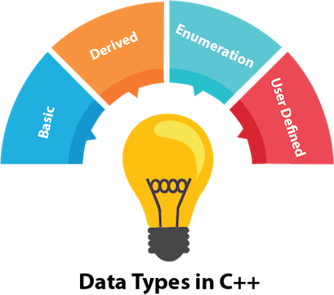
C++ Data Types
A data type specifies the type of data that a variable can store such as integer, floating, character etc.

Slide 18
There are 4 types of data types in C++ language.
Types | Data Types
Basic Data Type | int, char, float, double, etc
Derived Data Type | array, pointer, etc
Enumeration Data Type | enum
User Defined Data Type | structure

Slide 19
Data Types | Memory Size | Range
char | 1 byte | -128 to 127
signed char | 1 byte | -128 to 127
unsigned char | 1 byte | 0 to 127
short | 2 byte | -32,768 to 32,767
signed short | 2 byte | -32,768 to 32,767
unsigned short | 2 byte | 0 to 32,767
int | 2 byte | -32,768 to 32,767
signed int | 2 byte | -32,768 to 32,767
unsigned int | 2 byte | 0 to 32,767
short int | 2 byte | -32,768 to 32,767
signed short int | 2 byte | -32,768 to 32,767
unsigned short int | 2 byte | 0 to 32,767
long int | 4 byte
signed long int | 4 byte
unsigned long int | 4 byte
float | 4 byte
double | 8 byte
long double | 10 byte

Slide 20
Examples of Data types
int myNum = 5; // Integer (whole number) float myFloatNum = 5.99; // Floating point number double myDoubleNum = 9.98; // Floating point number char myLetter = 'D'; // Character bool myBoolean = true; // Boolean string myText = "Hello"; // String

Slide 21
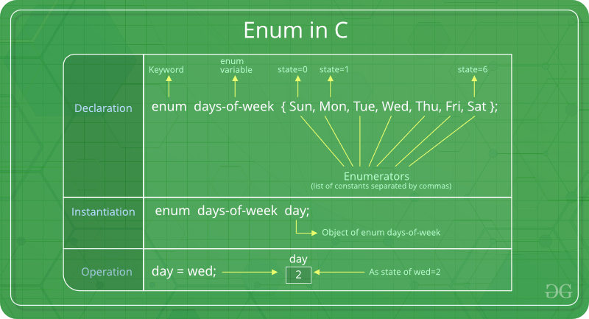
Enumeration data type
Enumeration (or enum) is a user defined data type in C++.
It is mainly used to assign names to integral constants, the names make a program easy to read and maintain.

Slide 22
Example of enumeration data type
#include <iostream>
using namespace std;
enum week{Mon, Tue, Wed, Thur, Fri, Sat, Sun};
int main()
{
enum week day;
day = Wed;
cout<<day;
return 0;
}

Slide 23
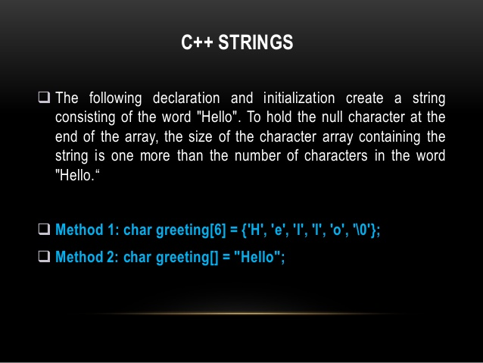

Slide 24
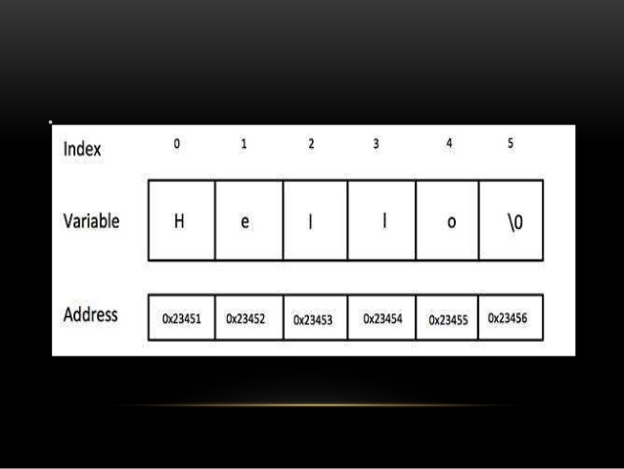

Slide 25
String Types
The string type is used to store a sequence of characters (text). This is not a built-in type, but it behaves like one in its most basic usage. String values must be surrounded by double quotes:
Example
string greeting = "Hello"; cout << greeting;
To use strings, you must include an additional header file in the source code, the <string> library:
Example
#include <iostream.h>
#include <string.h>
int main() {
string greeting = "Hello";
cout << greeting;
return 0;
}

Slide 26
Structures and Unions in C++
A structure is a user-defined data type available in C++ that allows to combining data items of different kinds. Structures are used to represent a record.
Defining a structure: To define a structure, you must use the struct statement. The struct statement defines a new data type, with more than or equal to one member.
The format of the struct statement is as follows:
struct [structure name]
{
member definition;
member definition;
... member definition;
};

Slide 27
union
A union is a special data type available in C++ that allows storing different data types in the same memory location.
Defining a Union: To define a union, you must use the union statement in the same way as you did while defining a structure. The union statement defines a new data type with more than one member for your program.
The format of the union statement is as follows:
union [union name]
{
member definition;
member definition;
member definition;
};

Slide 28
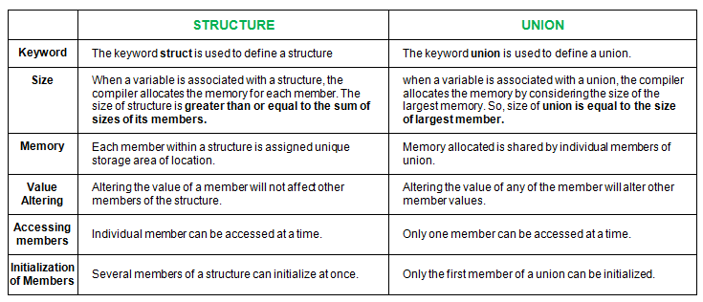
Differences between structure and
union

